Slide 1
Chapter 2 Google Approach
By:Umer farooq

Slide 2
Google's Approach to Search
PageRank (PR) is an algorithm used by Google Search to rank web pages in their search engine results. PageRank is a way of measuring the importance of website pages. According to Google: PageRank works by counting the number and quality of links to a page to determine a rough estimate of how important the website is.
A/B testing (evaluator)
Public testing

Slide 3
Google Search Page Structure
Direct answer box
Featured snippets (Paragraphs)
Featured snippets (bullet list)
Table design
Rich snippets(Ratings)
Local pak(Map)
Knowledge graph
People may ask
Image pack
News box

Slide 4
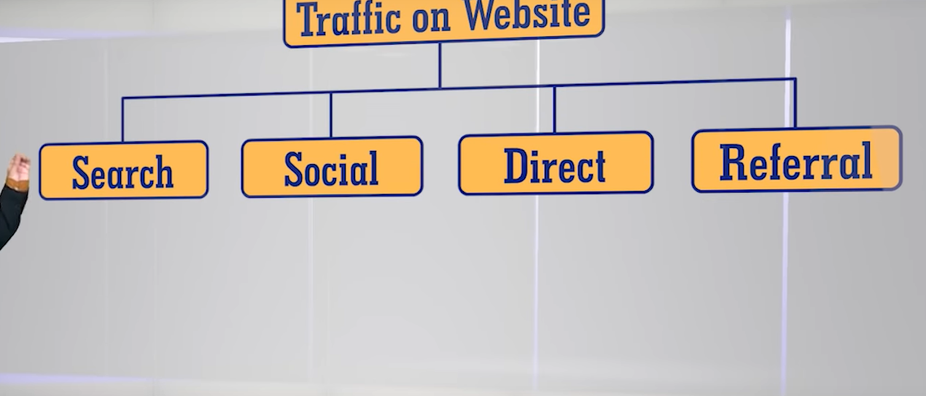
Digital Media & SEO

Slide 5
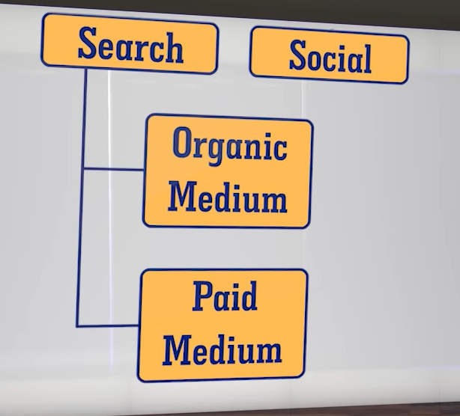
Search

Slide 6
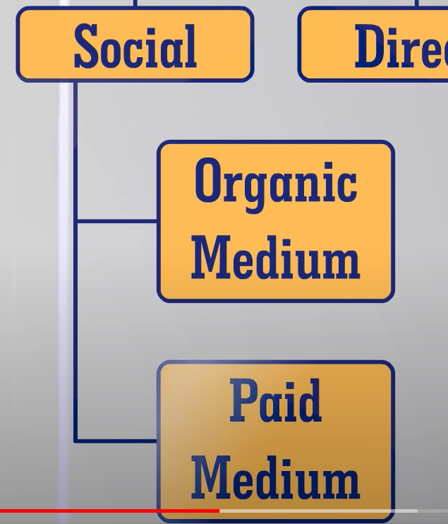
Social

Slide 7
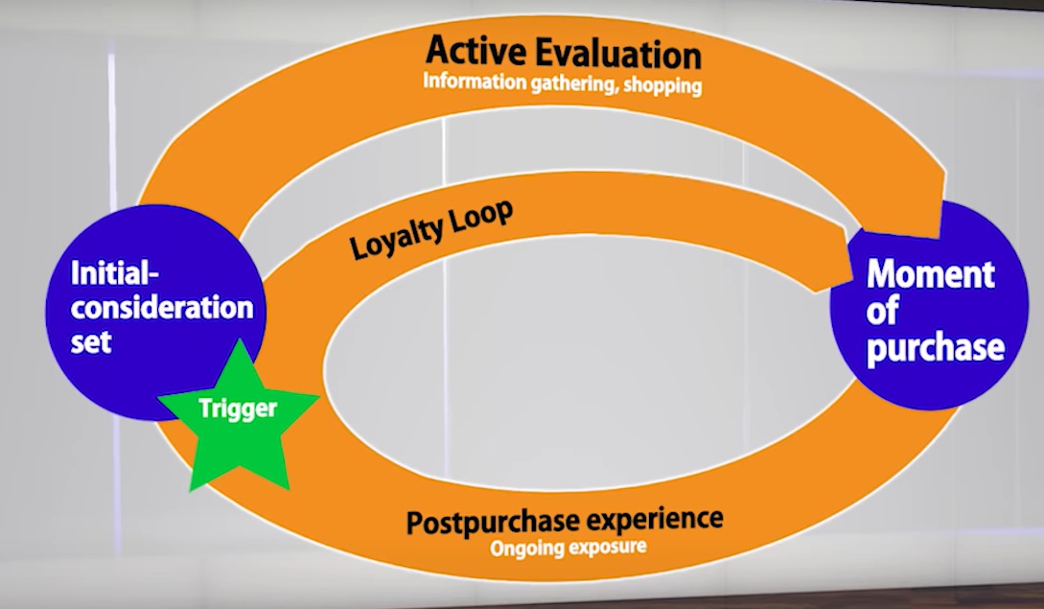
What is a Loyalty Loop and How can SEO help in getting Prospects?
Searching
Best shoes in hyderabad

Slide 8
What is PESO Model?
PESO stands for “paid, earned, shared, owned,” media and serves as a means of segmenting all of the marketing channels at a brand's disposal into discrete groups.

Slide 9
What is Outbound Marketing?
Outbound marketing refers to any kind of marketing where a company initiates the conversation and sends its message out to an audience. ... Outbound marketing is the opposite of inbound marketing, where the customers find you when they need you.

Slide 10
What is Inbound Marketing?
Inbound marketing is a business methodology that attracts customers by creating valuable content and experiences tailored to them. inbound marketing forms connections they are looking for and solves problems they already have.

Slide 11
How does Search play a role in Successful Inbound Marketing?
SEOs can provide copywriters with keyword data, trends, tracking and sharing tactics. These are all valuable ways to help strangers find piece of content.

